Slide 1
Paper Flow
Partitioning our System

Slide 2
Create a Paper Flow
Our goal here is to create a paper flow for a process
Then we can use that paper process to think about how we could partition our system
Team Topologies calls these points “fracture planes”
For an event driven architecture, fracture planes around “hand offs”, inbox to outbox help us build a robust system
”ACID” transactions take place at a desk; “BASE” takes place across desks

Slide 3
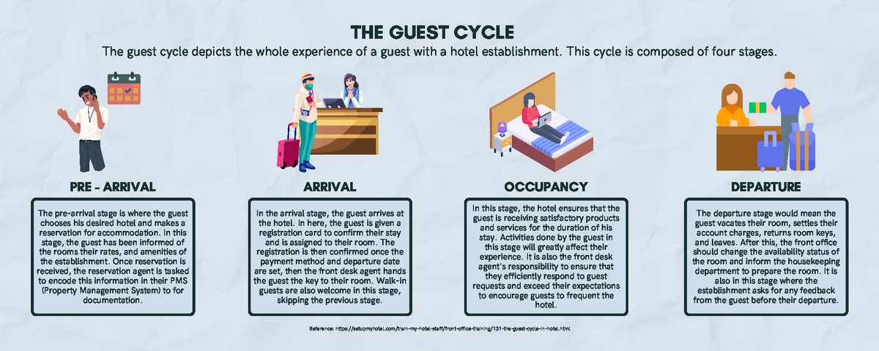

Slide 4
Pick One Step and Model As A Paper Flow
Onboarding a Hotel is another Step we can model
How do we get hotels into our catalogue?
Pre-Arrival and Arrival
Pre-Arrival is booking a stay
Arrival is check-in at the desk
You can make assumptions about outputs of prior steps
Onboarding: A catalogue of hotels
Pre-Arrival: A booking
Arrival: A Key
Occupancy is less obvious
Try: making a purchase from Room Service
Assume a Room Service Menu
Departure is how I get my bill
Show how the flow of bills reaches my file

Slide 5
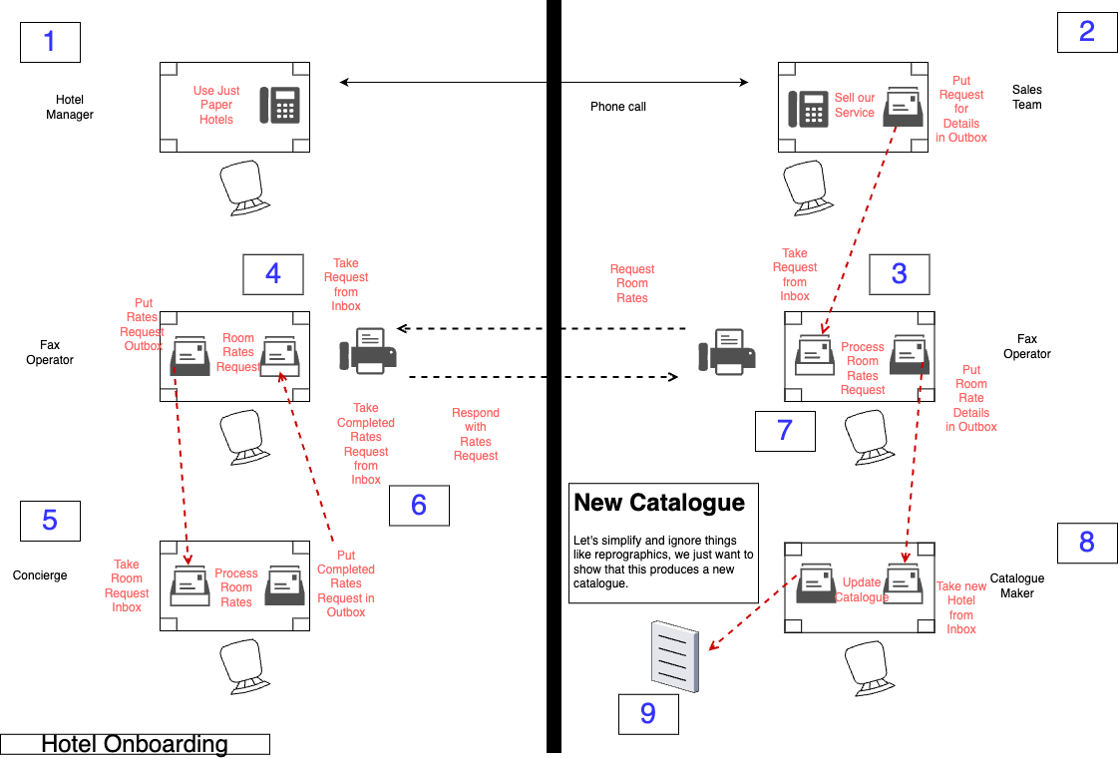

Slide 6
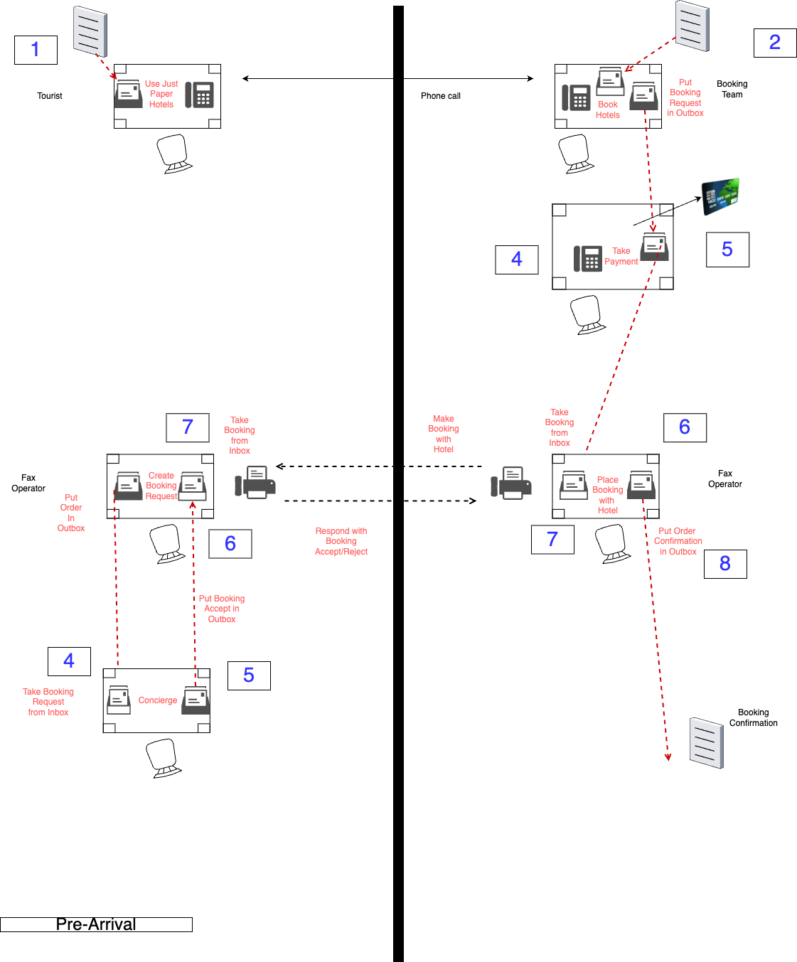

Slide 7
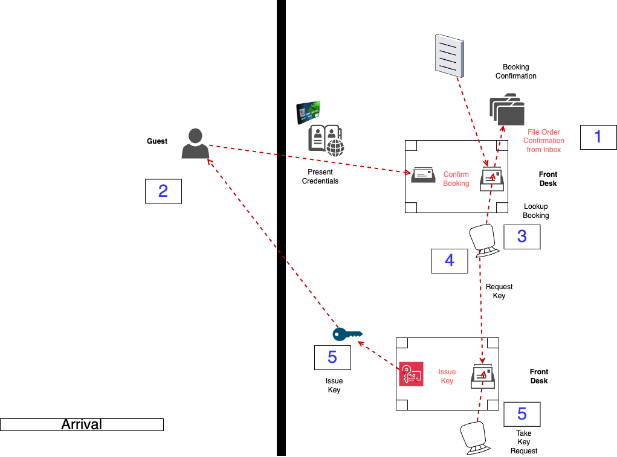

Slide 8
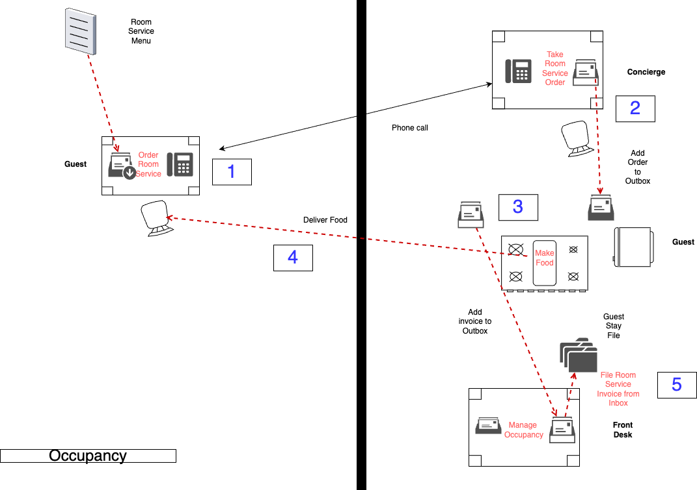

Slide 9
What Would This Look Like?
Take any Step from the Paper Model and think of it in FBP
What are the Information Packets, Nodes and Ports
Where do we have lookups?
Where do we need to store state?
Think about what patterns of messaging we might have?
In-Out?
Out-Only?

